Slide 1

A Comparative Study on Individualism & Collectivism
跨文化交际02班 马婉荣 韩喻泷

Slide 2
Contents
01 Definitions of Individualism and Collectivism
Advantages & Disadvantages 02
03 The Influence on Daily Life
Chinese Values Behind Collectivism 04

Slide 3

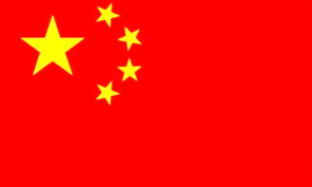




Individualism
Collectivism
ME culture
WE culture

Slide 4


Definition
Collectivism
Individualism
Collectivism refers to the principle of giving a group priority over each individual in it.
Individualism refers to the principle of being independent and self-reliant (自立的), or a social theory favoring (主张) freedom of action for individuals over collective or state country.

Slide 5
Characteristics
Collectivism
Individualism
group unity and harmony
individual autonomy
group-oriented
self-oriented
group goals
personal goals
conforming and interdependent
unique and independent
group belongingness
individual privacy
extended family
nuclear family
equality
equity
cooperation
competition

Slide 6
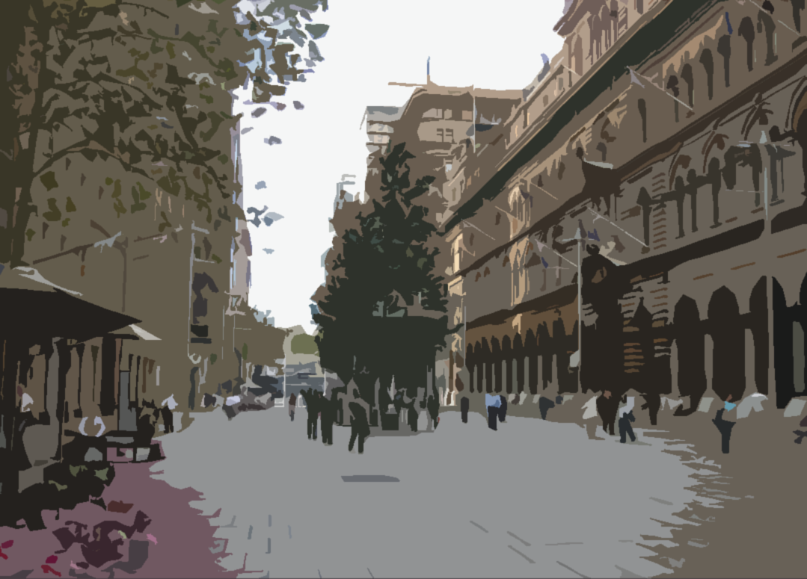
Advantage & Disadvantage

Slide 7



Slide 8


Slide 9
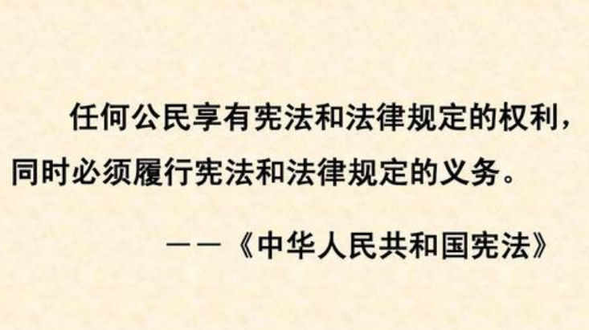
About Individualism
Disadvantages
Individualism is not conducive（有益的） to the development of the individual and the collective together.
Advantages
The first is that people know how to use the law to protect their rights, which is different from selfish. The second is that people know how to think independently and have their own ideas and opinions.

Slide 10
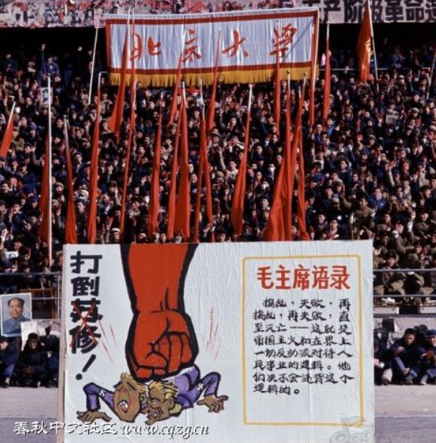
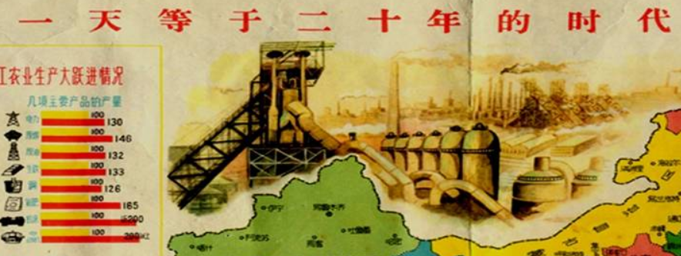
The Great Leap Forward 大跃进
The Great Cultural Revolution
文化大革命

Slide 11
About Collectivism
Disadvantages
Political democracy(政治民主) is too little, easy to produce individualism worship(个人崇拜) ;The economic management is too strict and the overall economic benefit is poor.
Advantages
Collectivism is extremely important under the objective and historical conditions of national and social interests. Without it, the society will not have cohesion(凝聚力).

Slide 12
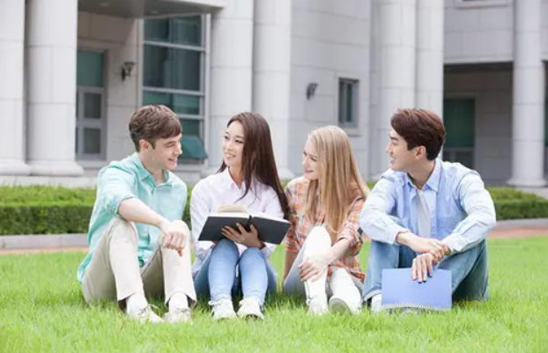
Balance
Individualism and collectivism can somehow be mixed with or tempered by each other. In this view, neither “extreme” individualism nor “extreme” collectivism are correct. Rather, wisdom and truth lie somewhere in the middle.

Slide 13
Influence on Daily Life

Slide 14

Spiderman : Into the Spider-verse

Slide 15
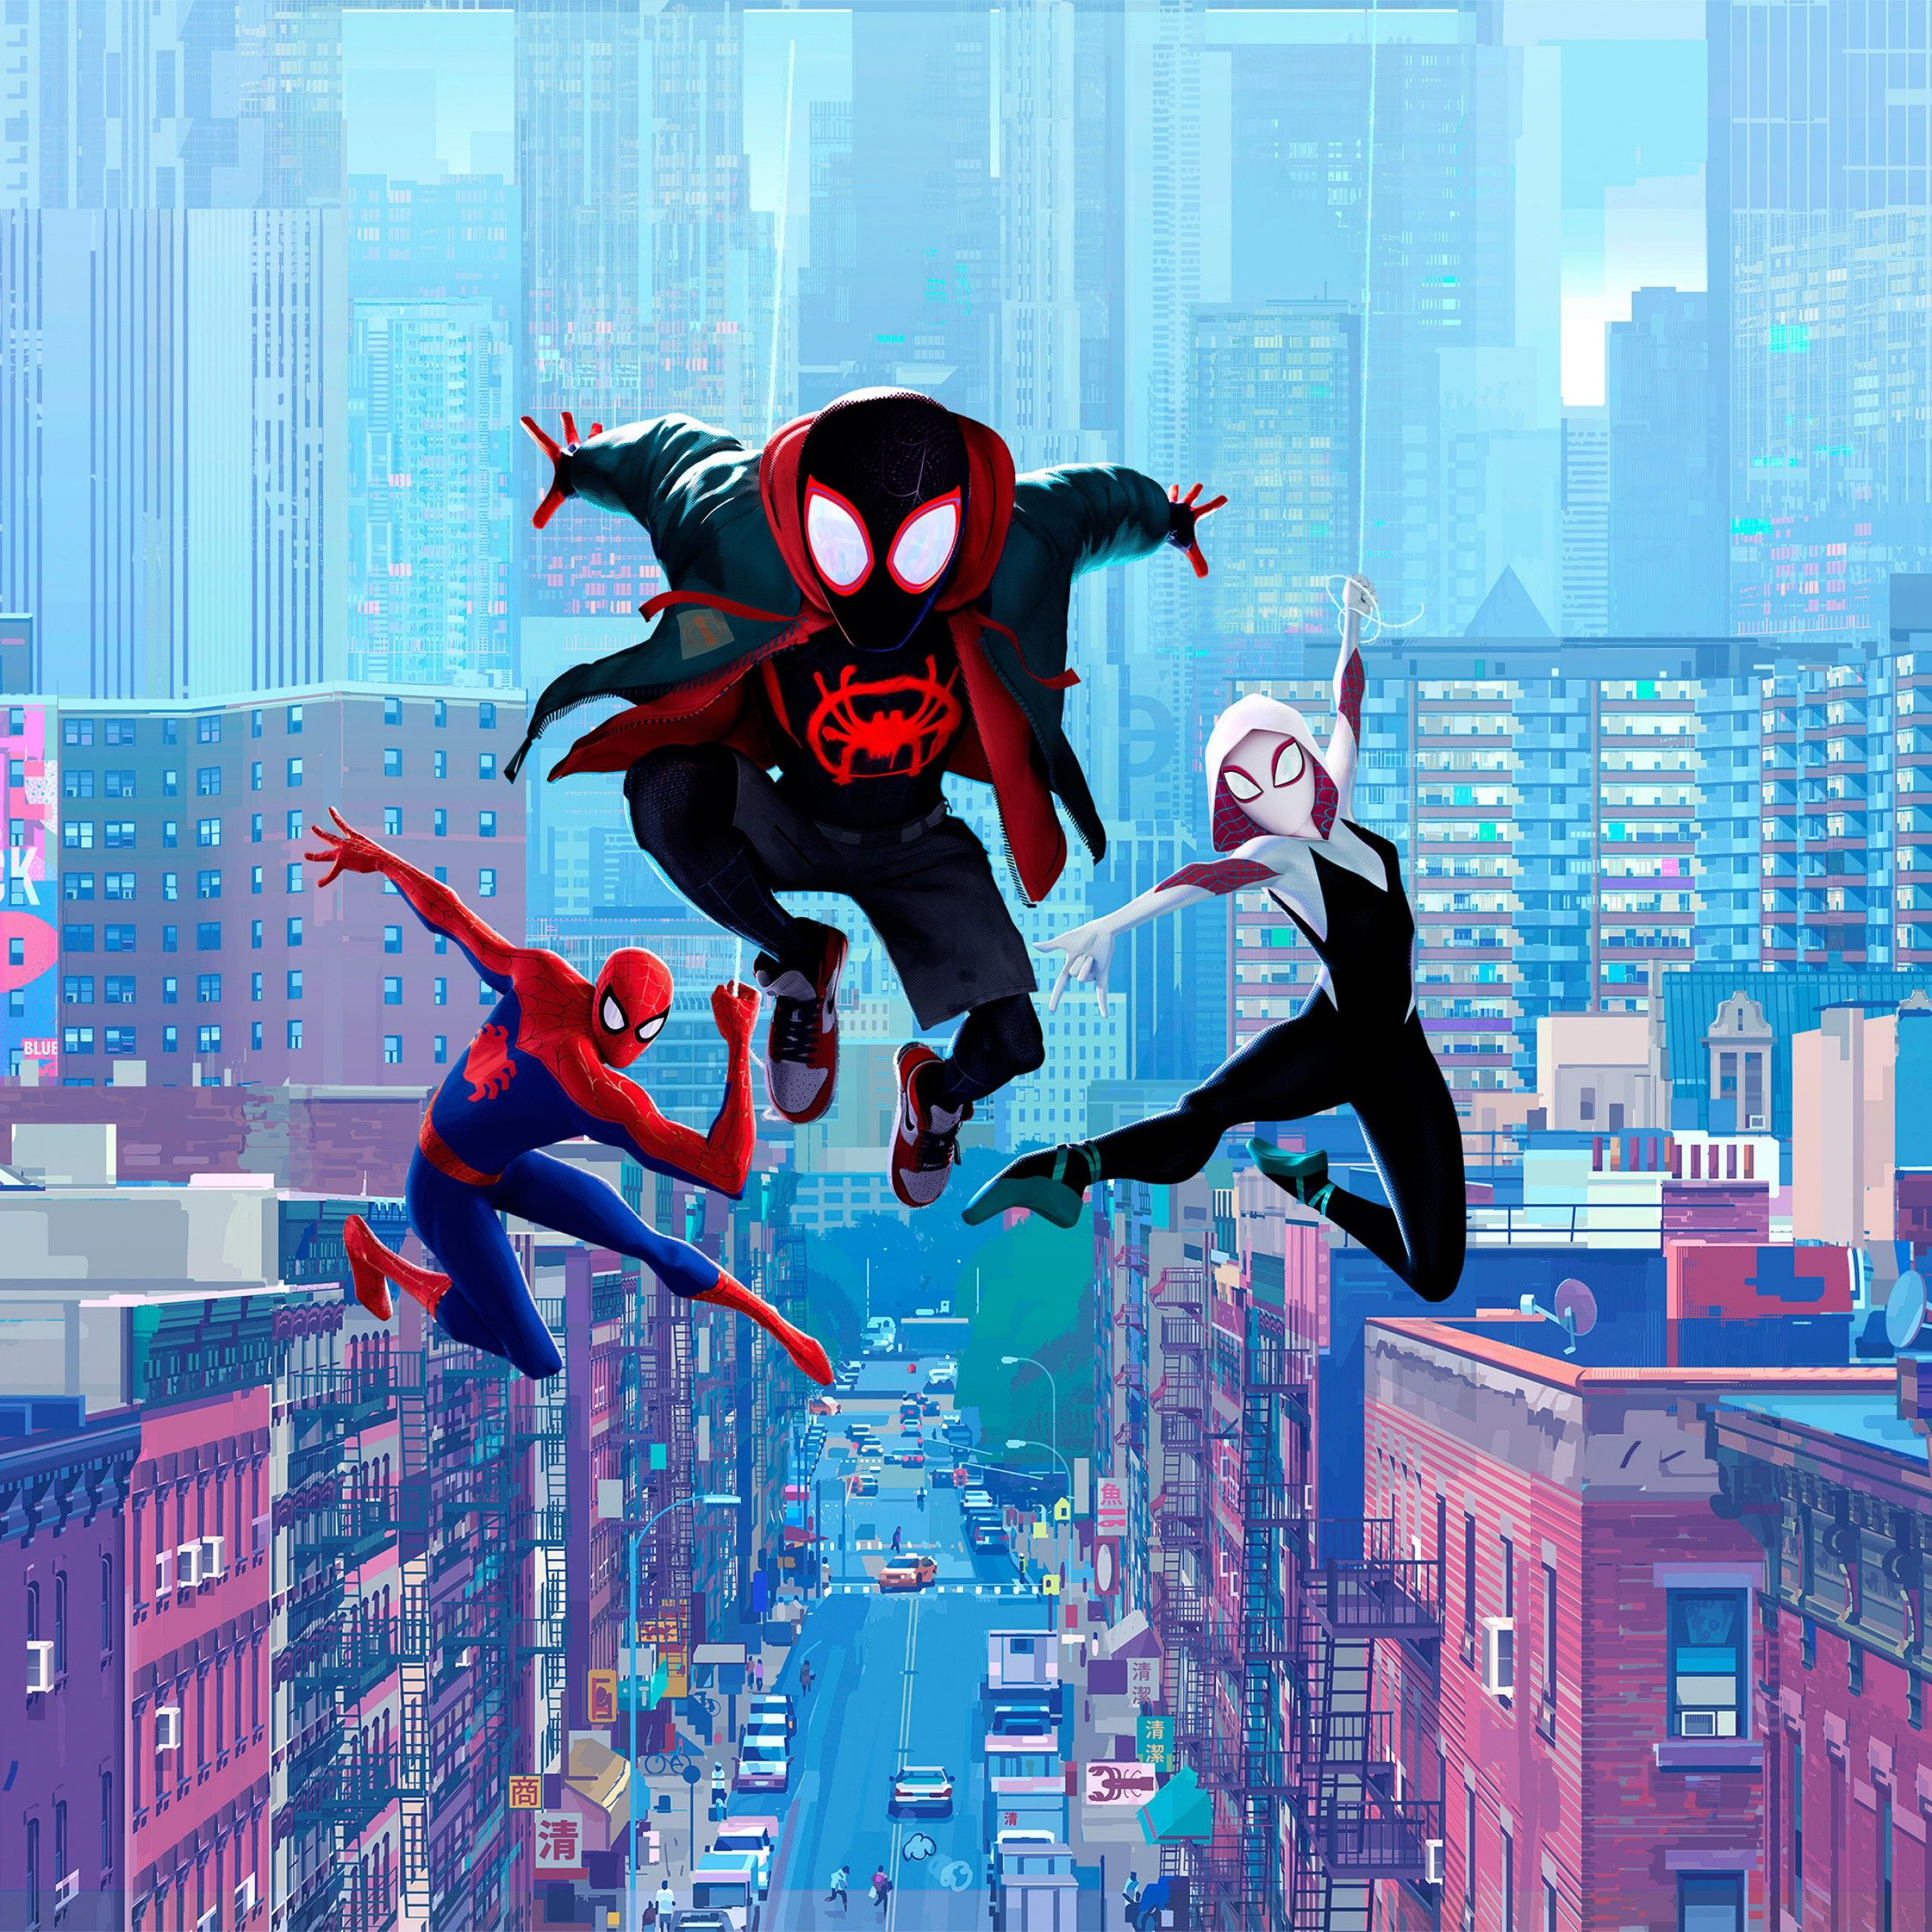
On individuals’ ability
The “Superhero”
in American culture
It is the idea of an anarchic(无政府的) individualism, of the reluctant superhero detached from mainstream society. The individual experiences a sense of selfhood, the individual knows that he or she exists in the world, through constant inner turmoil(动荡) and by confronting insurmountable(不可逾越) external threat.

Slide 16
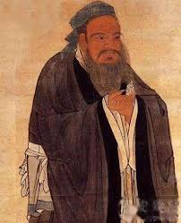
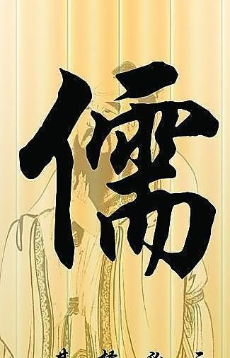
On individuals’ ability
Confucianism
The core parts of Confucianism’s view on individuals’ abilities are: Benevolence, righteousness, courtesy, wisdom, faith, forgiveness, loyalty, filial piety.

Slide 17
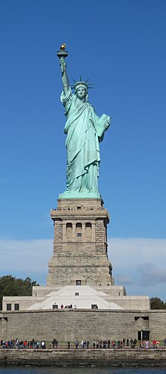
Family structure and values
The American family is nuclear consisting of parents and children. Comparing the extended family, including grandparents, aunts, uncles, cousins, nephews and nieces, the nuclear family is the smallest family unit.
The American family usually has its own separate residence(住处) and is economically independent of other family members.

Slide 18
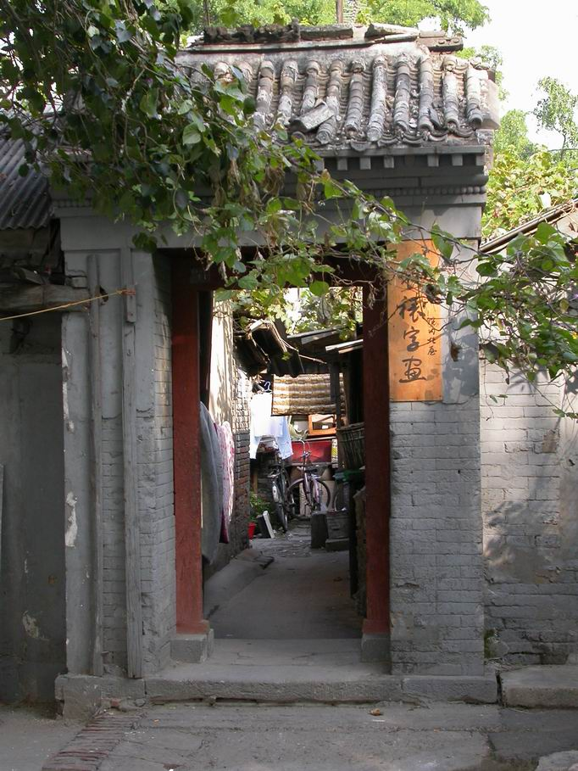
Family structure and values
Men went out to work and earn money, while women stayed at home, raising children and doing housework. And the whole family was administered by a patriarch(家长) (usually a man) of noble character and high prestige.
In the past the Chinese family was large, which concluded several small individual families. Altogether there could even be about 10 people living in one large household.

Slide 19
Life styles
What’s your opinion?
“Dread about the future, wish to know how to relax”
“Satisfied by the way things are going in my life these days”
“I like to visit places that are totally different from my home”
“Dressing well is an important part of my life”
“Live in the same town in the rest of my life”

Slide 20
Tendency ↓
Expectation
Individualist
“Satisfied by the way things are going in my life these days”
Travel
“I like to visit places that are totally different from my home”
Individualist
Stress
Collectivist
“Dread about the future, wish to know how to relax”
Appearance
Collectivist
“Dressing well is an important part of my life”
Living place
“Live in the same town in the rest of my life”
Individualist

Slide 21
Chinese Cultural Values behind our collectivism
Confucianism
Taoism
Buddhism
Socialism with Chinese characteristics

Slide 22
Thanks for watching!
2021.6.5

